Slide 1
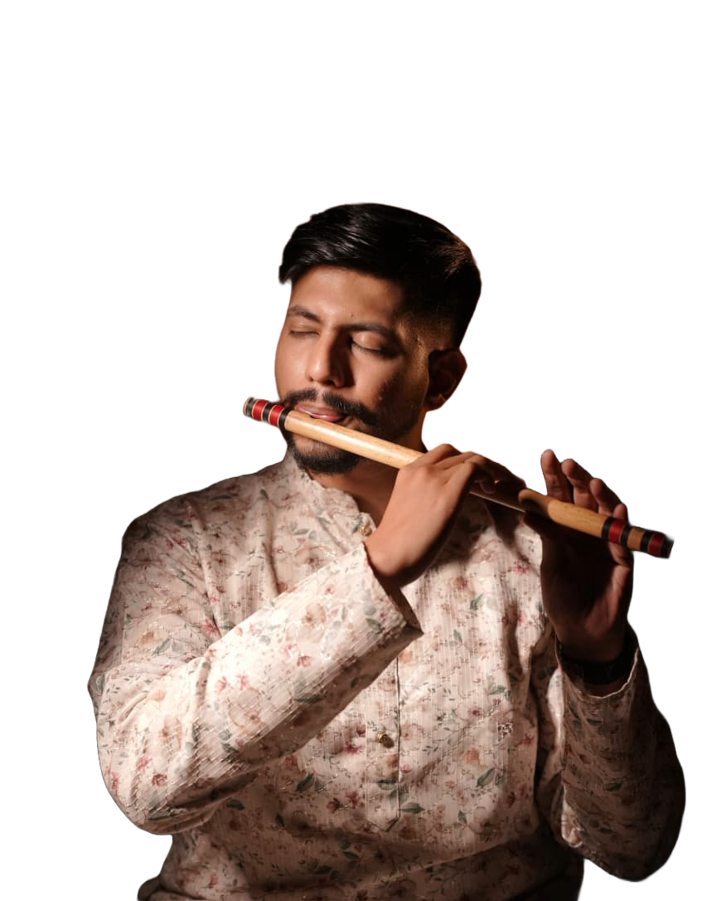
Satej KaRandikar
Artist profile

Slide 2
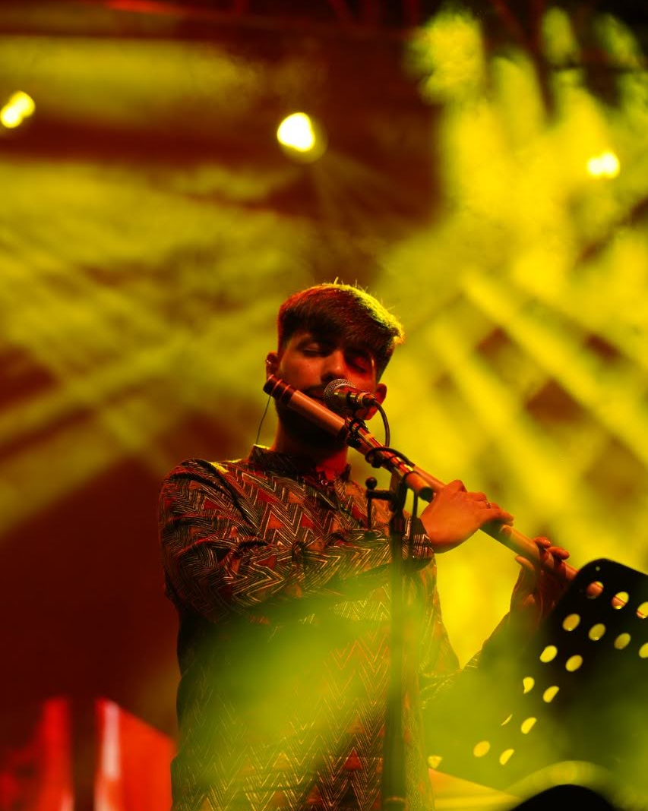
About Satej
I’m a Mumbaikar who wasn’t steeped into music at the earliest, but when I did, I took to it like fish to the water!
I have completed my Bachelor’s in Mass Media (Advertising) and have worked as a Media Planner. I left the corporate field to pursue a career in Music in 2016.
Hindustani Classical Music ticks all the right boxes for me and I have been learning it since the past decade and performing since the last 7 years. I have done a lot of recording sessions for Films, Web series and TV.
Fun trivia: I have a black belt degree in Karate (Shotokan style)

Slide 3
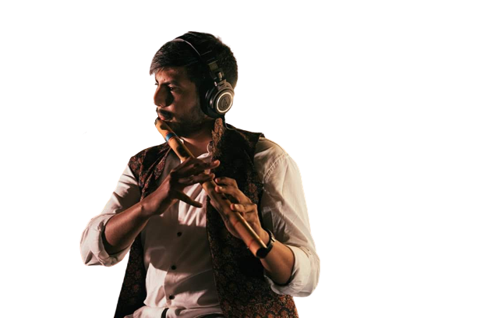
Skills
Performer
Dubbing Artist
Teacher
I perform Hindustani Classical Solo/Jugalbandi, Semi Classical and Devotional Songs, Orchestras and Concept Shows
I have dubbed for several BGMs like Rohit Shetty’s Simmba, Thakerey, Mann Ki Baat, Tarri, Punahsch Hari Om, etc. I can play folk style, classical and western style of Flute. I am comfortable playing with the metronome and I am good with Double takes.
I have over 5 years of teaching experience. I have taught students internationally as well over online sessions. I teach Hindustani Classical with a focus on technical excellence..

Slide 4
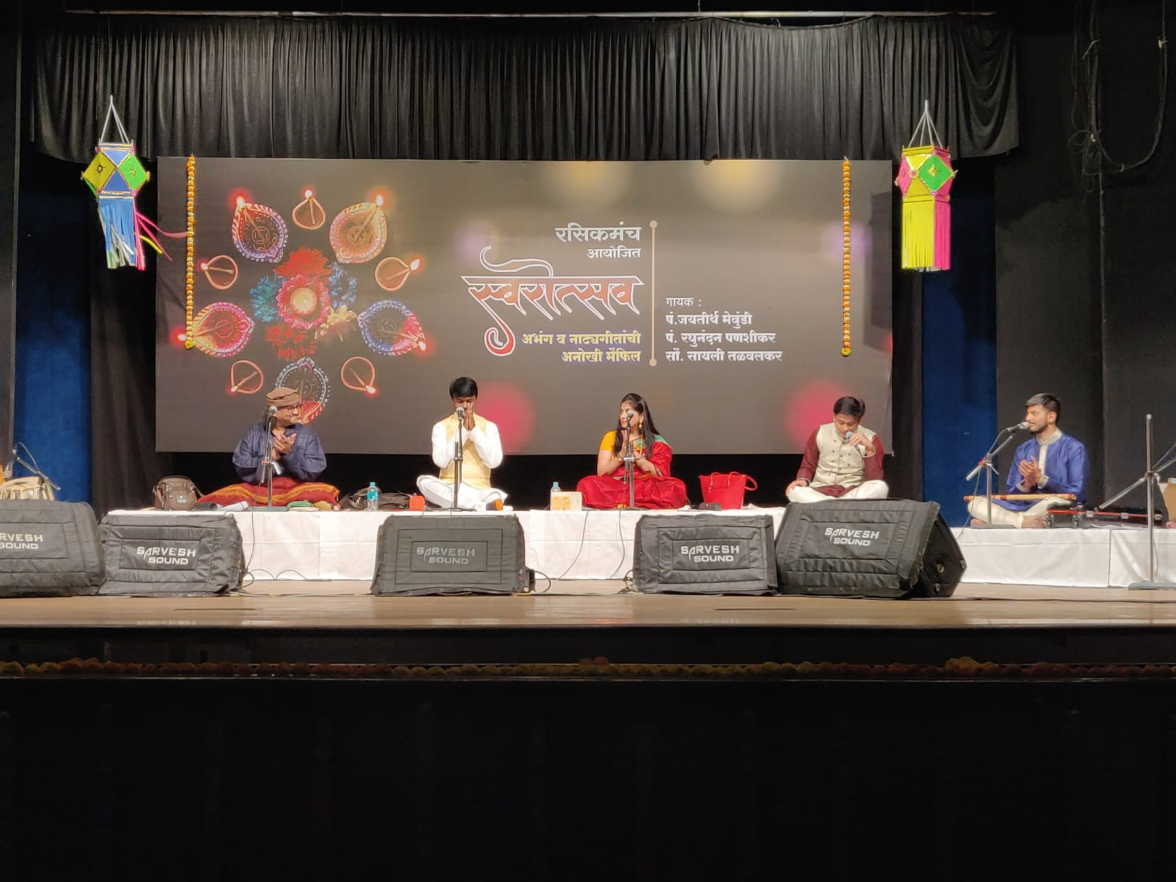
Performances
I have performed with some of the most celebrated names in the Music Industry. Be it Leslie Lewis of the Colonial Cousins, famous Music director Amit Trivedi, Indie performer Kanishk Seth or renown Classical vocalists like Pt. Jayateerth Mevundi, Pt. Raghunandan Panshikar, Sawani Talwalkar, Shridhar Phadke, Pt. Ratan Mohan Sharma, Ankita Joshi et al.

Slide 5

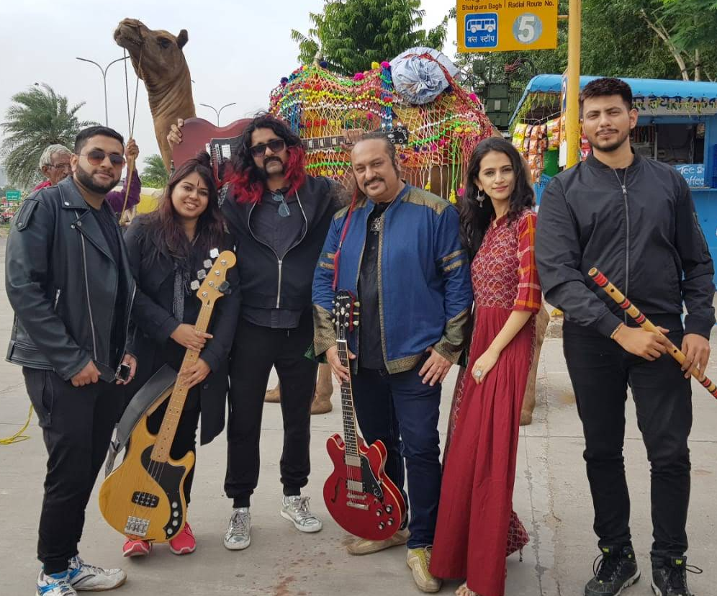

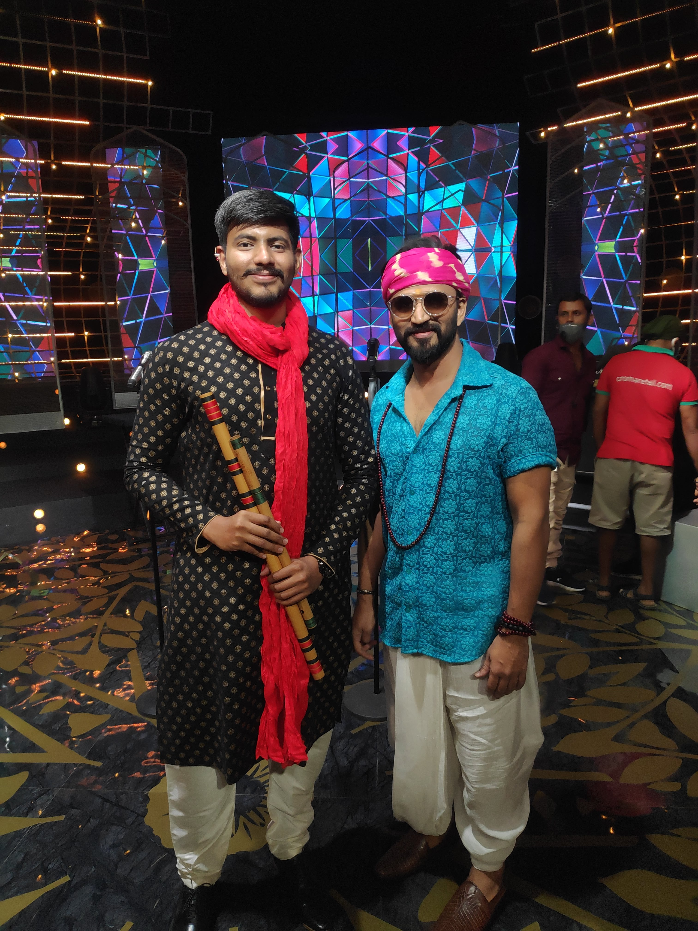
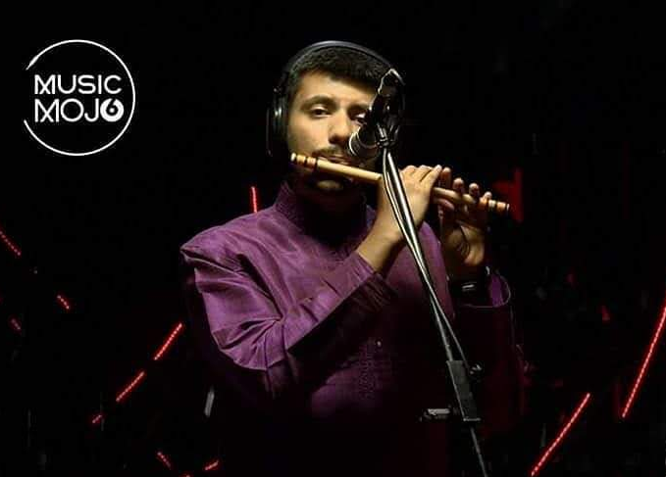
Three picture collage

Slide 6
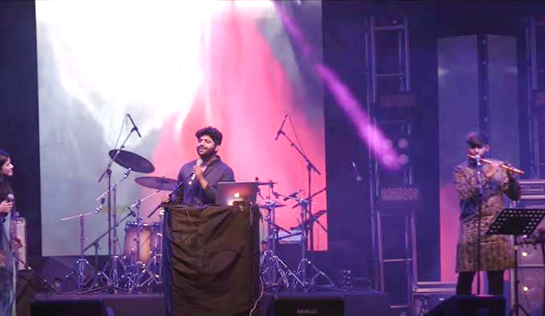
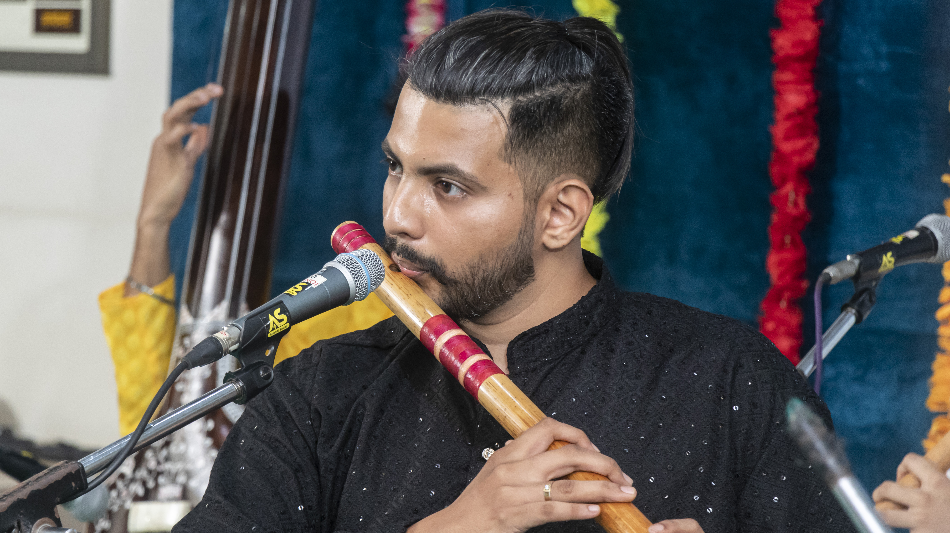
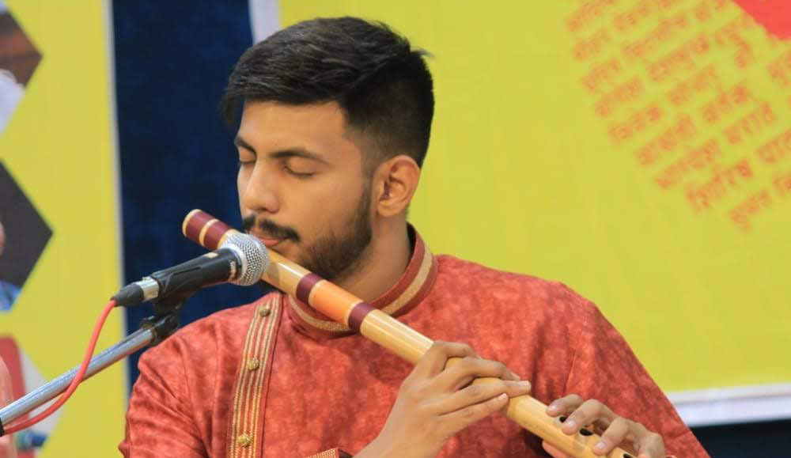
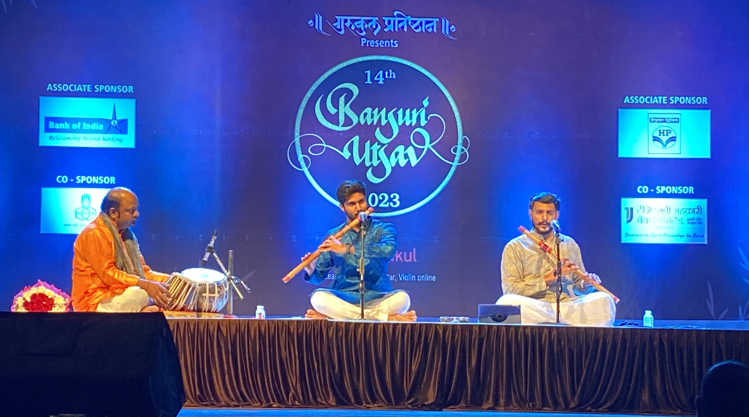

Slide 7
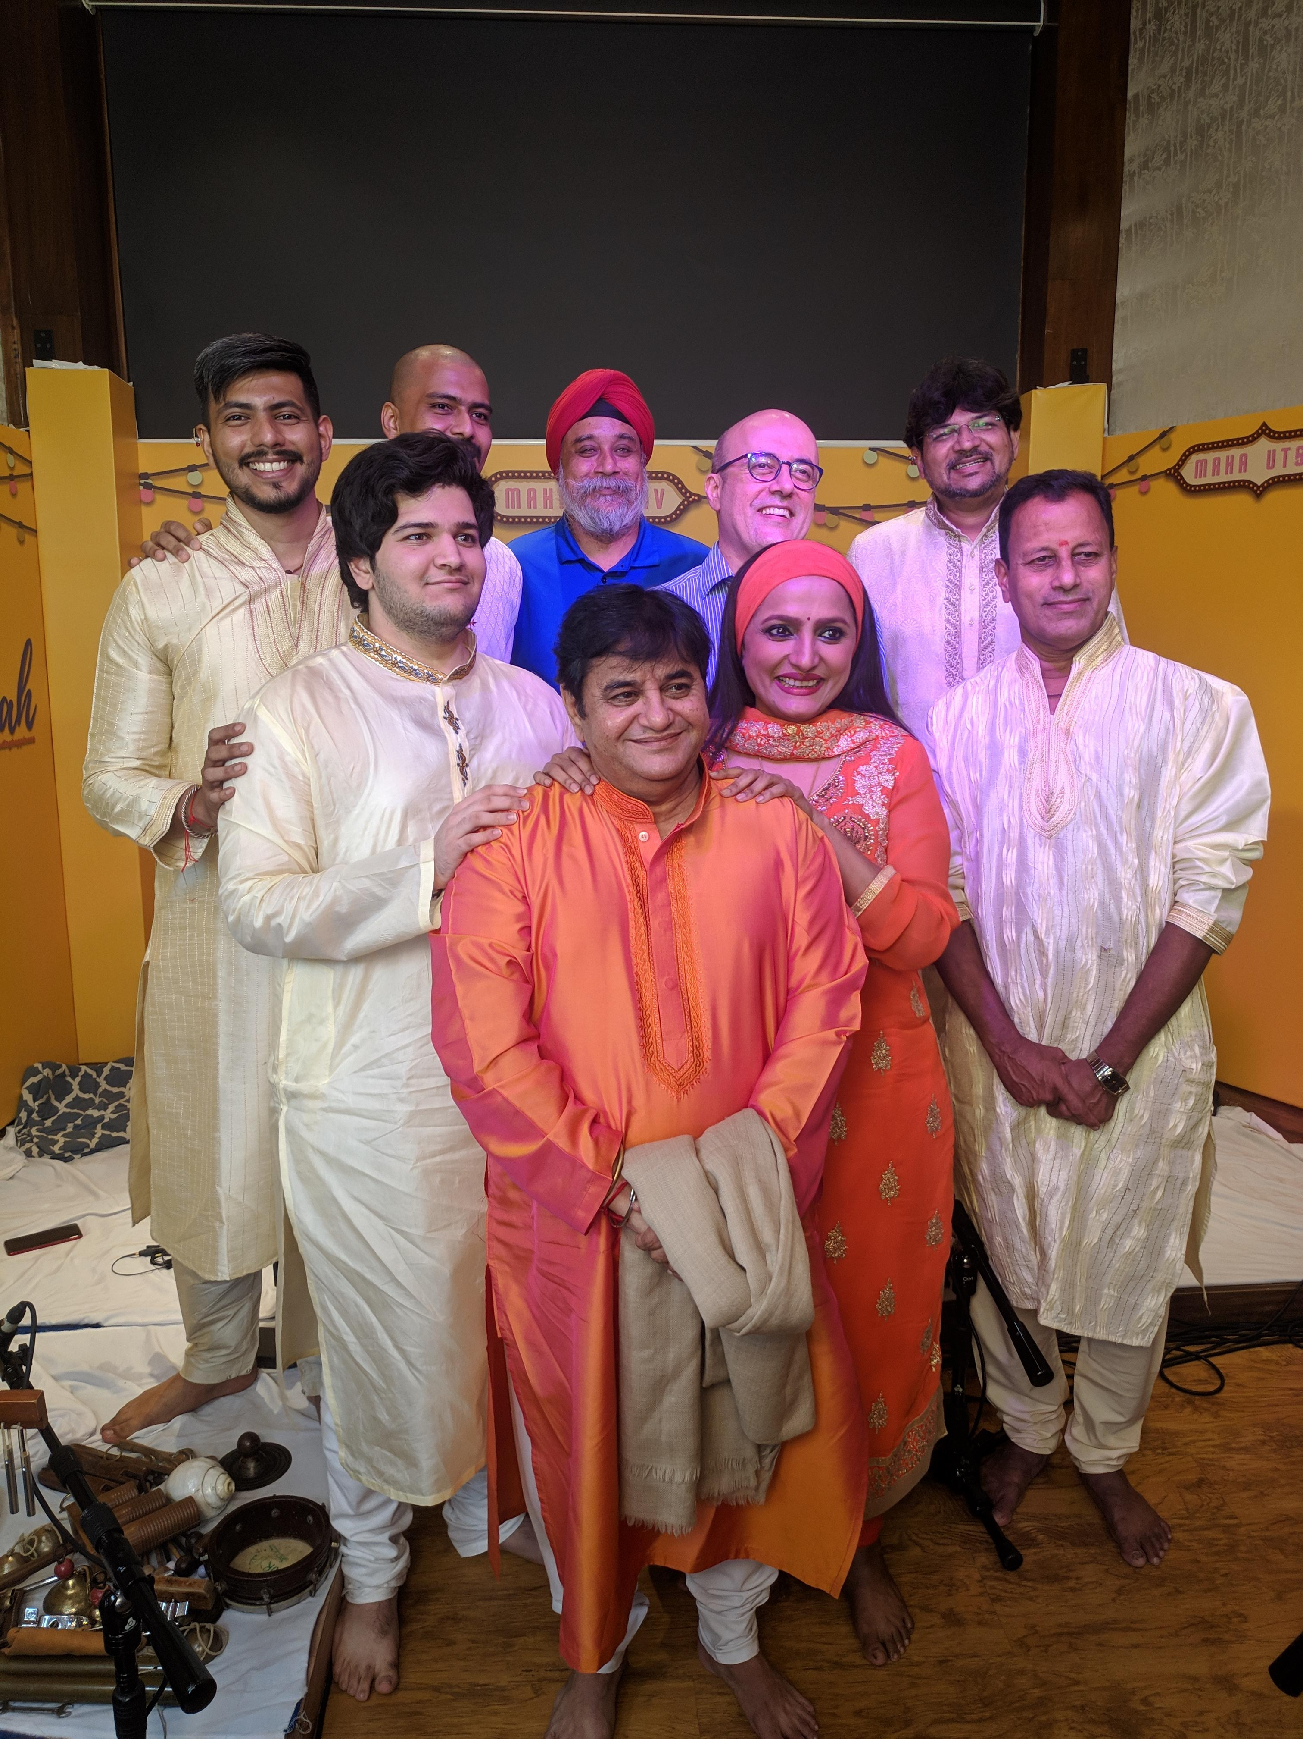
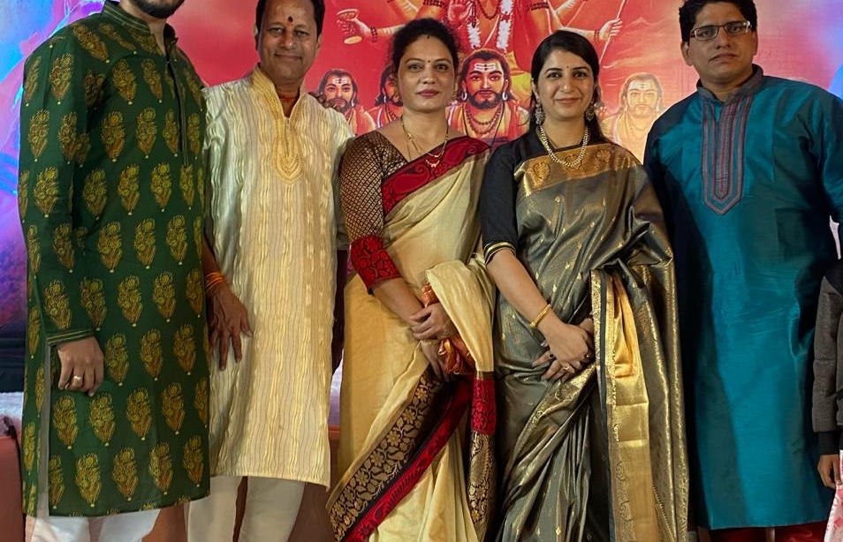

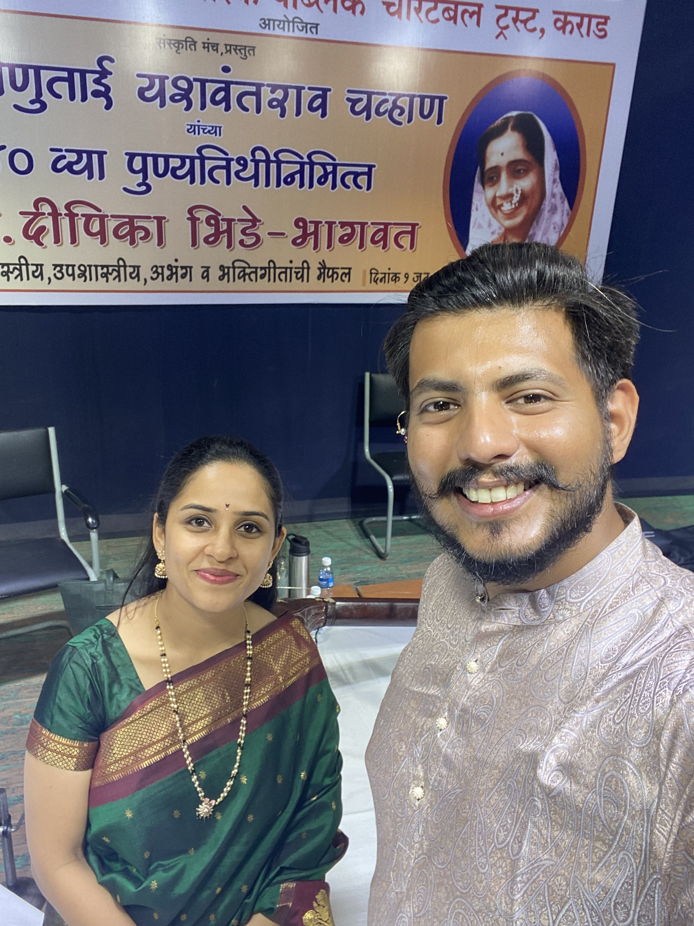
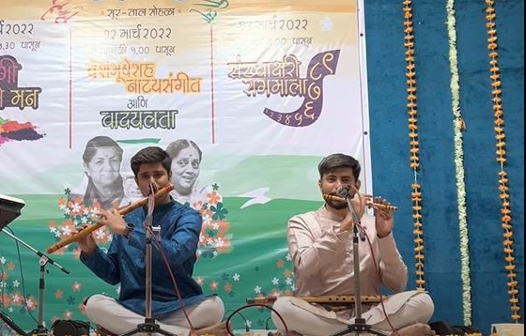
Four picture collage

Slide 8
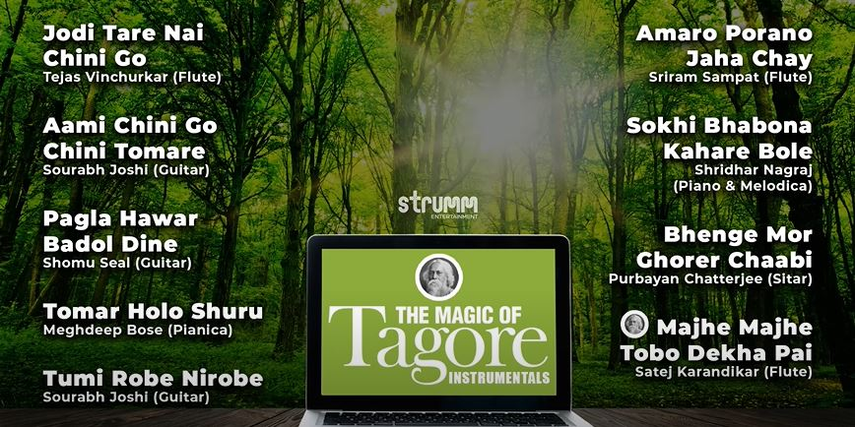
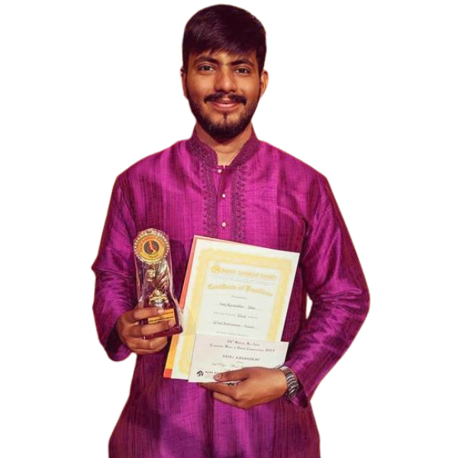
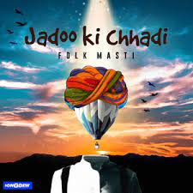

achievements
Whizclassical Award
Swar Sadhana Award
Yuva Gandharva Puraskar
Played for Albums like Tagore for Today, Swami Majha Sakha, Jadoo ki Chhadi and singles like Sakala Bhaya (Raman Iyer), Majha Bappa Kiti Goad Disto (Pravin Koli)
Played for the Theme song of Music reality show ‘Sur Nava Dhyas Nava’.
Featured with the great music composer Amit Trivedi for his project ‘Songs of Faith’
Performed in several orchestras for Amar Khanda Group, Shridhar Phadke, Anand Palwankar
Performances at Thane Festival, Sanskriti Arts Festival, Mumbai Fest, Kala Ghoda Festival with band ‘Melody Front’
Performed on Music Mojo by Kappa TV with band ‘Folk Masti’.
Started a music school under the name of ‘Vaadi School of Music’ in 2019.

Slide 9
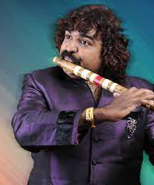
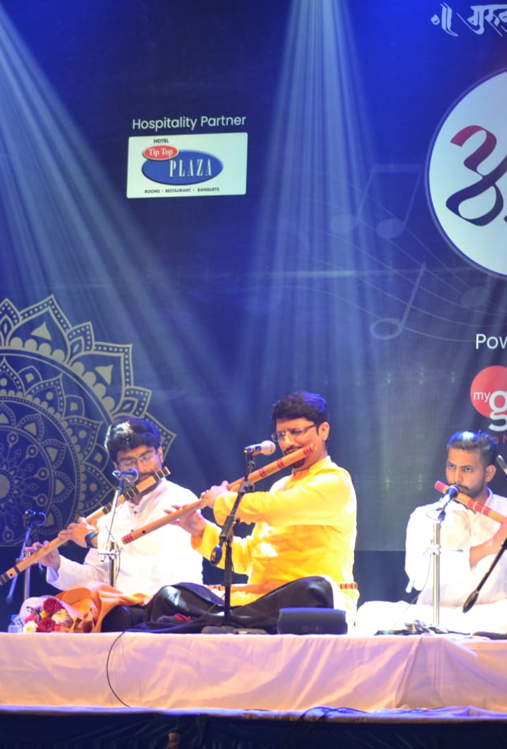
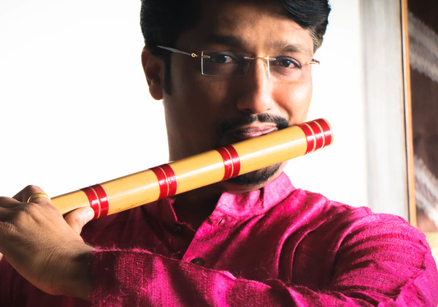
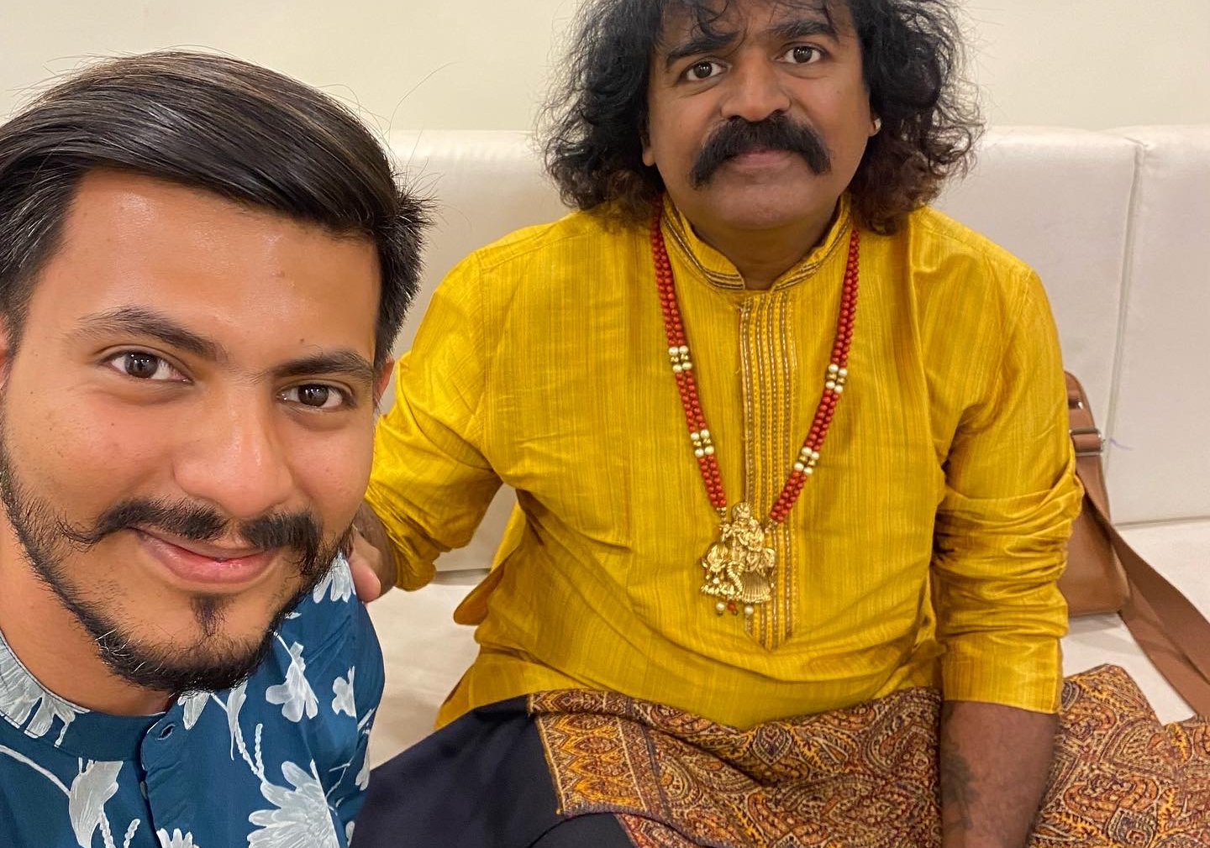
Five picture collage
Guru: Pt. Vivek Sonar
Vivek Sonar is a senior disciple of Pt.
Hariprasad Chaurasia ji. He is the founder of Gurukul Pratishthan and has created the app ‘myGurukul’ which teaches Hindustani Classical Music on Bansuri, Violin, Sitar and Tabla He is also the pioneer of ‘Bansuri Utsav’ – India’s largest Flute festival.
Guru: Pt. Pravin Godkhindi
Pravin Godkhindi ji is an internationally acclaimed flutist who follows the Kirana Gharana style of Hindustani Music. His command over the Gayaki style of Music makes his repertoire unique.

Slide 10
THANK YOU
mangaldhwani92@gmail.com
(+91) 9004259799
Instagram: @satejkarandikar
Facebook: @satejkarandikar

